Slide 1
C++高级程序设计
Advanced Programming in C++
（part 1）
郑 滔 zt@nju.edu.cn 费彝民楼904室
潘敏学 mxp@nju.edu.cn 费彝民楼927室

Slide 2
No modern system is written exclusively in a single language,
but C++ plays in a major role here
What Is C++ Used For?
2015 4.4M
everywhere
everything
Invisible deep （in the infrastructure of important systems）
NASA’s deep space network
familiar gadgets, such as coffee machines, dishwashers
Industry
Telecom AT&T、Ericsson、Huawei、Siemens
Mobile Signal processing、screen rendering
Microelectronics AMD、Intel、Nvidia
Finance Morgan Stanley
Games
Graphics and animation Maya、Disney 、SideFx
Block chain implementation Ripple
Database SAP、 Mongo、MySQL 、Oracle
Cloud Google、Microsoft 、IBM 、Amazon
AI and ML TensorFlow
Operation support Maersk、AT&T
Software development
tensorFlow、tools、libraries、compilers
run-time code generation、LLVM
XML and JSON parser
heterogenous computing
Web infrastructure
Browsers Chrome、Edge、Safari、Firefox
Javascript engines
JVMs
Google and similar organizations search、map-reduce
Science
Aerospace Space X、Mar Rovers、James Webb Space Telescope
High Energy Physics CERN 、SLAC 、FermiLab
Biology genetics、genome sequencing
Exascale cpmputing
Major Web applications Alibaba、Amazon、Facebook
Engineering Lockheed Martin
Automotive ADAS、machine vision(OpenCV)
Embedded systems
Security Kaspersky、Symantec
Medicine and biology CT
Teaching

Slide 3

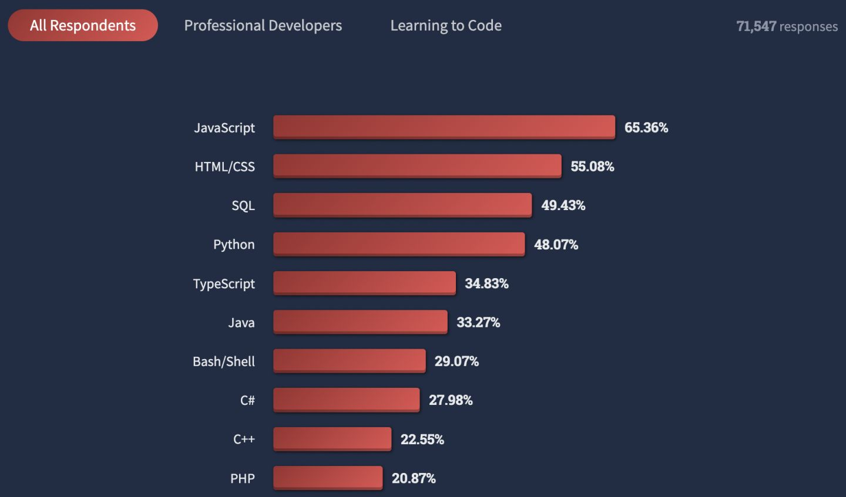
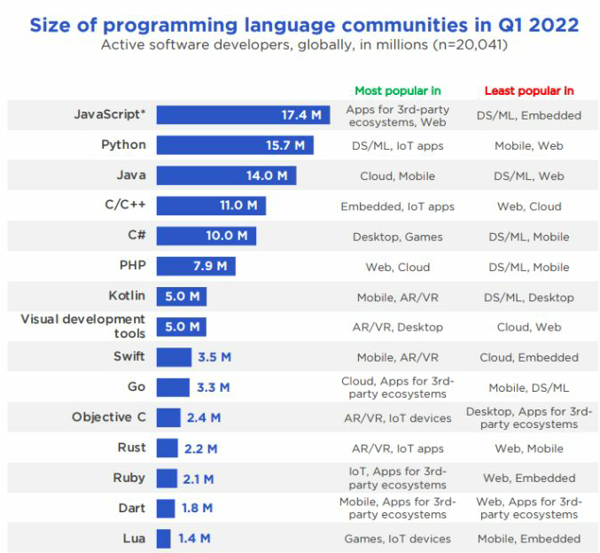

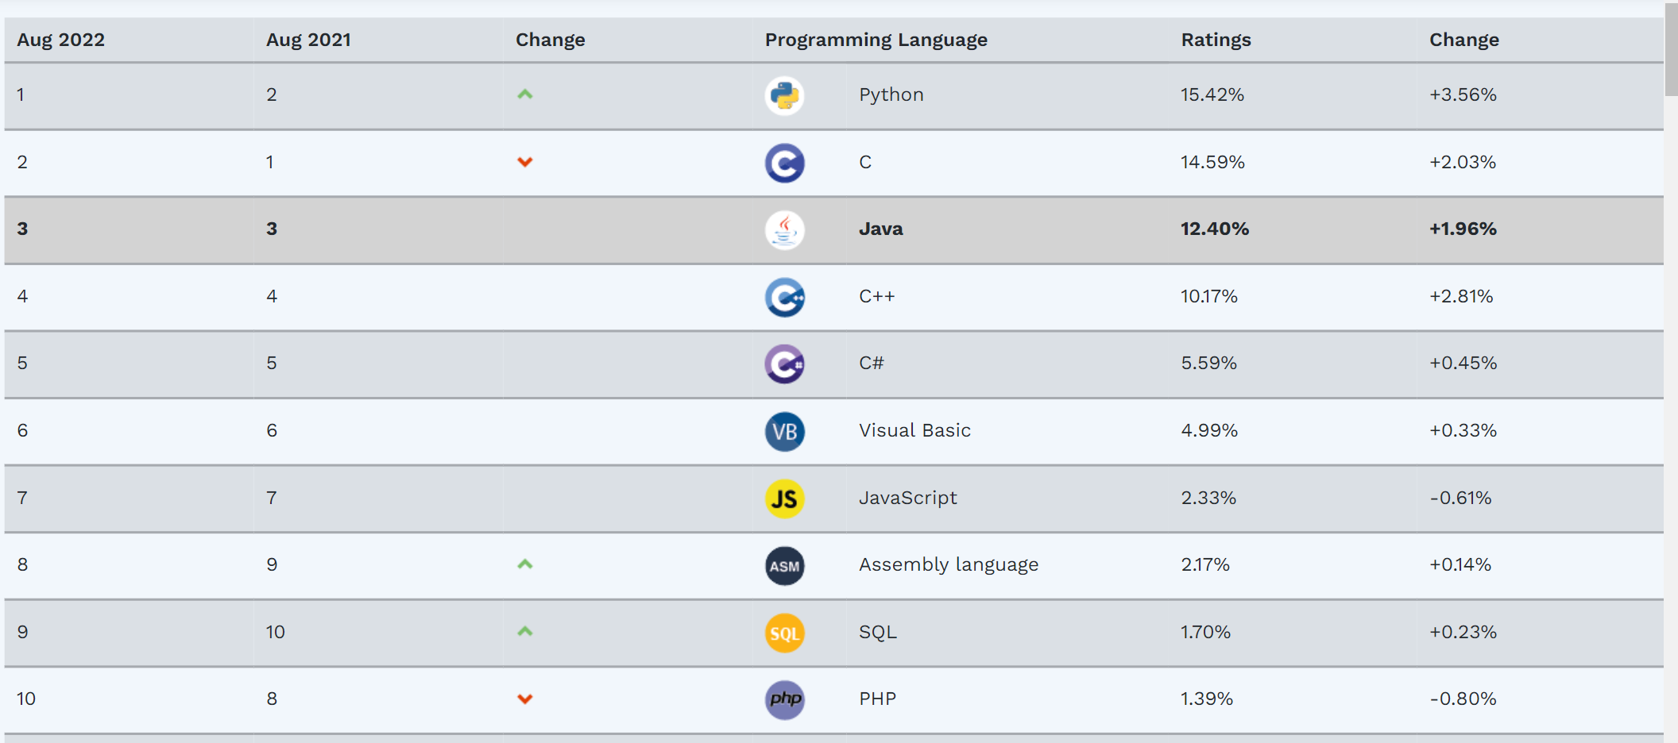
TIOBE
The Importance of Being Earnest

Slide 4
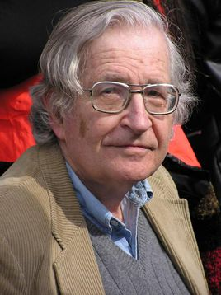
Language
  Syntax、Semantics、Pragmatics
  Avram Noam Chomsky MIT
    1955
    RG FA
    CFG PDA
    CSG LBA
    PSG TM
Backus–Naur Form
Deduct
Reduce
G=（V_{N}，V_{T}，P，Z）
ad hoc

Slide 5
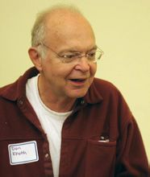
Programming
The Science of programming David Gries
The Art of Computer Programming Donald Ervin Knuth
calculus
    aesthetic experience
    efficiency of the corresponding machine program

Slide 6
Programming Paradigm
Imperative Programming paradigm
  Structural Programming
  Object-Oriented Programming
Declarative Programming Paradigm
  Functional Programming
  Logical Programming

Slide 7
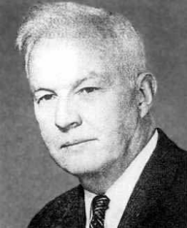
Functional Programming
Haskell Brooks Curry
int Fib(int n)
{
if (n <= 2)
reurn 1;
int f1 = 1; int f2 = 1; int temp = 0;
for (int i = 2; i < n; i++)
{ temp = f1 + f2;
f1 = f2;
f2 = temp;
}
return temp;
}
代码简洁，易于理解
代码管理
并发
int Fib(int n)
{
if (n == 1 || n == 2)
return 1;
return Fib(n - 1) + Fib(n - 2);
}

Slide 8
class node{
public:
int start = 0;
int end = 0;
node(int _start,int _end){
start = _start;
end = _end;
}
};
void quickSort(int A[],node node0){
vector<node> STACK;
int s = -1; int t = -1;
STACK.push_back(node0);
while (true){
if (STACK.empty()){ return; }
else{
node tmp = STACK.back();
STACK.pop_back();
s = tmp.start;
t = tmp.end;
if (s >= t){
continue;
}
}
int i = s; int j = t + 1;
while (true){
do{
i++;
} while (A[i]<A[s] && i < t);
do{
j--;
} while (A[j] > A[s] && j>s);
if (i < j){
std::swap(A[i], A[j]);
}
else{
std::swap(A[s], A[j]);
break;
}
}
STACK.push_back(node(s,j-1));
STACK.push_back(node(j+1,t));
}
}
FP - QSort
quicksort :: Ord a => [a] -> [a]
quicksort [] = []
quicksort (p:xs) = (quicksort lt) ++ [p] ++ (quicksort gt)
where lt = filter (<= p) xs
gt = filter (> p) xs
#include <algorithm>
#include <vector>
#include <numeric>
#include <iostream>
#include <iterator>
#include <range/v3/view/all.hpp>
#include <range/v3/view/filter.hpp>
#include <range/v3/view/concat.hpp>
#include <range/v3/range/conversion.hpp>
std::vector<int> quick_sort(const std::vector<int> &nums) {
if (nums.size() < 2) { return nums; }
auto lt_sorted = quick_sort(ranges::to<std::vector<int>>(nums | ranges::views::filter([&](const int &v) { return v < nums.front(); })));
auto eq_sorted = ranges::to<std::vector<int>>(nums | ranges::views::filter([&](const int &v) { return v == nums.front(); }));
auto gt_sorted = quick_sort(ranges::to<std::vector<int>>(nums | ranges::views::filter([&](const int &v) { return v > nums.front(); })));
return ranges::to<std::vector<int>>(ranges::views::concat(lt_sorted, eq_sorted, gt_sorted));
}
int main() {
std::vector<int> nums = {4, 5, 3, 6, 2, 1};
auto ans = quick_sort(nums);
std::copy(ans.cbegin(), ans.cend(), std::ostream_iterator<int>(std::cout, " "));
std::cout << std::boolalpha << std::is_sorted(ans.cbegin(), ans.cend()) << std::endl;
}

Slide 9
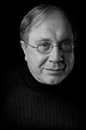
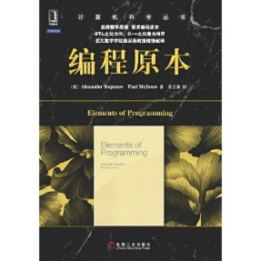
Generic Programming
建造真实的、高效的和不取决于语言的算法和数据结构
C++是GP的最佳载体
Alexander Stepanov
70年代末期
算法并不依赖于数据结构的特定实现
算法可以从特定实现中抽象出来, 而且效率无损
创造一种编程语言 Tecton
不想使用副作用, 但这一点限制了表达能力
ADT
把实现和接口分开
不应该忽略复杂度
1983 scheme建立工具箱
1985 建立ada库
副作用是很重要的
1987，进入贝尔实验室C++组, 从事库研究
首次尝试C++
C++中还没有template
用继承来获取通用性, 显然不理想
参与template讨论
template的设计方案是天才的
92年 建立STL，验证性项目
C++ STL ， P.J.Plauger，Alexander Stepanov， Meng Lee， David R.Musser
Elements of programming, Alexander Stepanov, Paul McJones
1993，C++程序设计的科学 San Jose
1994, Andy Koenig，STL成为标准库，bjarne stroustrup 成了STL的强有力支持者
滑铁卢投票

Slide 10
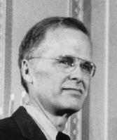
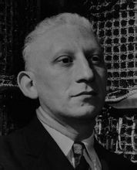

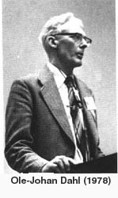
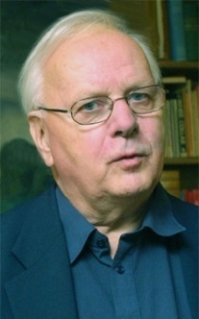

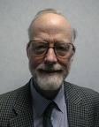
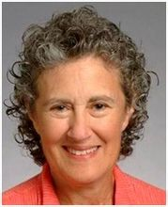
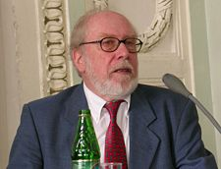
ＦＯＲＴＲＡＮ
Alan J．Perlis ，
1958,1966
E.W.Dijkstra
1960,1972
John Backus，
1953, 1977
Algol 60
Ole-Johan Dahl
Kristen Nygaard
1962, 2001
PL/1
BCPL
Simula 67
C
Dennis Ritchie
Ken Thompson
1972,1983
Algol 68
C With Classes
C. A. R. Hoare
1966,1980
Donald E.Knuth
1965,1974
ANSI C
CLu
Ada
……
C++
Barbara Liskov
1987, 2008
Niklaus Wirth
1966, 1994

Slide 11
1979 C with Classes
First non-research user
Language: classes, constructors/destructors, public/private,
simple inheritance, function argument type checking
Library: tasks (coroutines and simulation support)
vector parameterized with macros
“Remember the Vasa!”
1985 TC++PL1
First commercial release
Language: virtual functions, operator overloading, references, const
Library: complex arithmetic, stream I/O
FUTURE
Improved Unicode support
Support for simple graphics and simple user interaction
Support for new kinds of hardware
Exploration of improved styles and implementations of error-handling
Pursue the goal of a completely resource-safe and type-safe C++
Support a wide variety of hardware well
Maintain C++‘s record of stability (compatibility)
1989-91 TC++PL2
ANSI and ISO
Language: abstract classes, multiple inheritance, exceptions, templates
Library: iostreams (but no tasks)
1998 TC++PL3
C++98 the first ISO C++ standard
Language: namespaces, named casts, bool, dynamic_cast
Library: the STL (containers and algorithms), string, bitset
2011 TC++PL4
Language: memory model, auto, range-for, constexpr, lambdas, user-defined literals, ...
Library: threads and locks, future, unique_ptr, shared_ptr, array,
time and clocks, random numbers, unordered containers (hash tables), ...
2014 C++14
2017 C++17
Language: generic lambdas, digit separators,
local variables in constexpr func, ...
Library: user-defined literals, ...
Language: structured bindings, variable templates,
template argument deduction from constructors, ...
Library: file system, scoped_lock, shared_mutex (reader-writer locks)
any, variant, optional, string_view, parallel algorithms, ...
2020 C++20
2023
Language: Static reflection facilities
FP style pattern matching
Contracts
Library：coroutines
A modular standard library
executors
Networking
Language: concepts, modules, coroutines, three-way comparisons,
improved support for compile-time computation, ...
Library: concepts, ranges, dates and time zones, span,
formats, improved concurrency and parallelism support, ...

Slide 12
Tools
Industrial-strength IDE Visual Studio 、CLion
Online compiler Compiler Explorer 、 Wandbox
GUI libraries and tools Qt 、GTKmm、 wxWidgets
Analyzers Coverity ，VS C++ Core Guidelines 、Clang Tidy
Compiler tool support LLVM
Build system build2、CMake 、 GNUmake
Package manager Conan、 vcpkg
Run-time environment WebAssembly
Run-time compilation、JIT-ing and linking Cling 、RC++

Slide 13
Resources
Community
No center to the C++ community
no talent
no desire
disorganized
fragmented
Apple、Borland、GNU、IBM、Microsoft、Zortech
The C++ Core Guidelines
best practise
In 导言
P 理念
I 接口
F 函数
C 类
Enum 枚举
R 资源管理
ES 表达式和语句
Per 性能
CP 并发和并行
Per 性能
E 错误处理
Con 常量和不可变性
T 模板
CPL C风格的编程
SF 源文件
SL 标准库

Slide 14
Resources
Conference
Early (Absorbed/Mutated into general “OO” or “SD” conference)
Nowday (has C++ user’s Group)
CppCon The C++ Foundation
C++ Now BoostCon
Meeting C++
ACCU Association of C/C++ Users
QT、NDC、std::cpp
Blogs
Videos YouTube
Github

Slide 15
C和C++
Direct map to hardware
Zero-overhead abstraction
超集
C++ 支持 C 所支持的全部编程技巧
任何 C 程序都能被 C++ 用基本相同的方法编写，并具备同等开销（时间、空间）
兼顾细节与抽象

Slide 16
Declaration
Will
Problem driven
C++’s development should be driven by needs of specific real-world problems.
Simple
C++ should be grown by generalization from simple, efficient, easy-to-use solutions.
Efficient
The C++ language and standard library should obey the zero-overhead principle.
Stable
Don’t break my code!
Never
Experts only
A facility has to serve all the experts’ needs from the start.
Imitative
We need this facility because it is popular in “language X”.
Theoretical
Language theory says that a language must have this feature.
Revolutionary
This feature is so important that we must break compatibility or deprecate
“the bad old ways” of doing things.

Slide 17
Structural Programming
Data Structure＋Algorithm
ADT
Abstract Data Type
Associativity
Priority
Type conversion
Evaluation order
Side Effect
Precision
Overflow

Slide 18
Expression & Statement
Make simple things simple!
A programming language is there to
allow application ideas to be expressed,
not to turn programmers into language lawyers
auto
ES.11：Use auto to avoid redundant repetition of type names
Range-for
for
vector<int> vec{1,2,3};
for (auto i : vec )
cout << i;
eliminates the possibility for making a few “trivial” but common errors
void use(vector<int>& v, list<string>& lst)
{
for (int i=0; i<imax; ++i)
for (int j=0; i<imax; ++j) ... // bad nested loop
for ( int i =0; i <= max ; ++ i) ... // off -by - one error ?
}
vector<int> vec{1,2,3};
for (auto& i : vec ) {
i=i*i;
cout << i;
}
Uniform Initialization
providing equally good support for built-in and user-defined types
int a [] = {7 ,8}; // OK
vector <int > v = {7 ,8}; // should work ( obviously , but it did not )
constexpr
purely functional
User-Defined Literals

